Slide 1
Year 11 Prepa Talk
October 2020

Slide 2

Presentarán exámenes en abril/mayo 2021.
Son los mismos exámenes alrededor del mundo.
Certificado de Secundaria británico.
Es necesario cumplir con lo lineamientos, requisitos y estipulaciones de Cambridge.
Los exámenes en Año 11 en el 2021, tendrán un costo aprox de $20,000 MXN

Slide 3
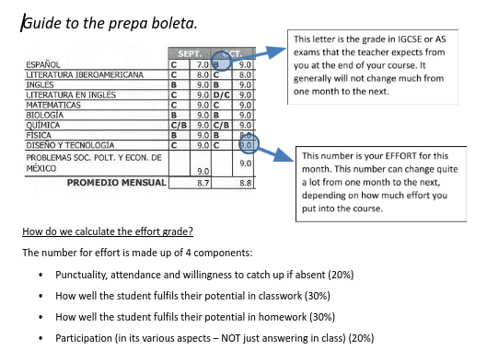
Boletas
Years 11 - 13 once a month

Slide 4
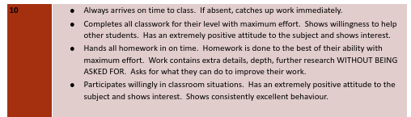

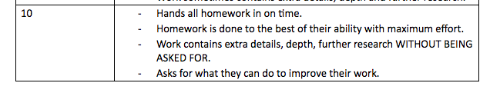
BOLETAS: Grading
How can I avoid low effort grades?
Try to produce work that you consider to be high quality, always push yourself to improve.
Show interest and enthusiasm, ask questions
Try to contribute to the “learning environment” of your whole group.
Plan your time sensibly at home (using your diary)
Avoid copying from other students or directly from source material
Try not to be absent.
Arrive to class on time
Talk to your tutor and/or your teacher if you feel you are having difficulties.

Slide 5
IGCSE Courses
Year 11: 4 options + core subjects (English Lang, English Lit, Spanish, Spanish Lit, Maths)
They will sit their final IGCSE exams at the end of year 11 in April / May of 2021.
Coursework is a part of many of the options though and this is just as important as exams
There will also be mock exams that are important to prepare for properly.
Important to miss as little time as possible from these exam courses in Prepa.

Slide 6

Criterios IGCSE
While we suggest 5 D grades or above as a rough guideline for A levels, the UNAM revalidation requires 6 pass grades (at G or above) but we really want to encourage more than this.
University applications
Future jobs
Academic careers
Really they should be trying to get as high as possible; As and Cs at IGCSE level are definitely attainable!

Slide 7
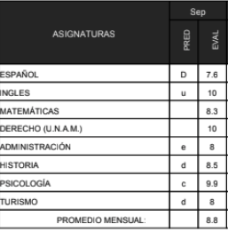
Communication about progress - GS
Regular Reports (Next in Nov)
Participation Intervention
Friday Feedback
Parent Meetings
We are always happy to talk if you want to arrange a meeting!

Slide 8

Revalidación
Revalidation: Year 11 - 6 G+ at IGCSE for the UNAM.
As a school, our guideline to go comfortably into Year 12 are 5 IGCSEs at D+.
It's at this level as a guideline for the academic level the AS levels involve, but there are other factors e.g. if they can do A level Art, if they can get their IELTS, etc.
Year 13: 4 AS levels E+ (A levels count as 2 so usually 100% have 2 with Spanish). An IELTS pass at 6.5 counts as an AS level also.

